Slide 1

Topic – Launching a local test blockchain
Notes:
“Operating Systems: Internal and Design Principles”, 8/e, Global Edition by William Stallings, Chapter 5 “Concurrency: Mutual Exclusion and Synchronization”.

Slide 2
Developing a SC
When developing, and testing a SC, and correcting errors, we better not use the mainnet where ether values are real.
Once the program is (believed to be) correct then only we deploy it on a real blockchain such as the mainnet
Truffle provides a tool to setup our own blockchain in our own machine, called ganache
Launching ganache can be done either through command-line or gui, and it is launched locally at http://localhost:PORT#, ie http://127.0.0.1:PORT#
Notes:
At first glance, it may seem that interleaving and overlapping represent fundamentally different modes of execution and present different problems. In fact, both techniques can be viewed as examples of concurrent processing, and both present the same problems. In the case of a uniprocessor, the problems stem from a basic characteristic of multiprogramming systems: The relative speed of execution of processes cannot be predicted. It depends on the activities of other processes, the way in which the OS handles interrupts, and the scheduling policies of the OS.

Slide 3

First, get it…
Download & install it, if you haven’t done so.
Search and look for the logo of ganache
Notes:
At first glance, it may seem that interleaving and overlapping represent fundamentally different modes of execution and present different problems. In fact, both techniques can be viewed as examples of concurrent processing, and both present the same problems. In the case of a uniprocessor, the problems stem from a basic characteristic of multiprogramming systems: The relative speed of execution of processes cannot be predicted. It depends on the activities of other processes, the way in which the OS handles interrupts, and the scheduling policies of the OS.

Slide 4
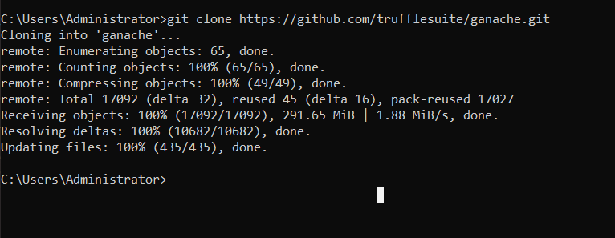
Or clone it from github
Notes:
At first glance, it may seem that interleaving and overlapping represent fundamentally different modes of execution and present different problems. In fact, both techniques can be viewed as examples of concurrent processing, and both present the same problems. In the case of a uniprocessor, the problems stem from a basic characteristic of multiprogramming systems: The relative speed of execution of processes cannot be predicted. It depends on the activities of other processes, the way in which the OS handles interrupts, and the scheduling policies of the OS.

Slide 5
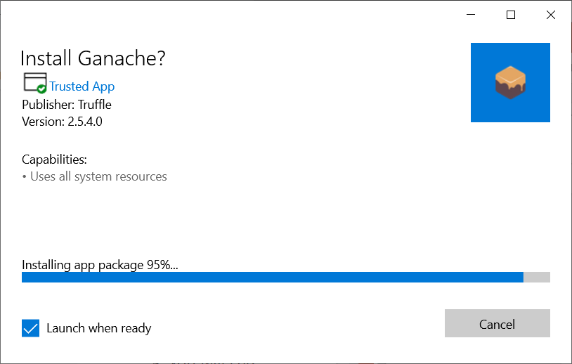
Youtube on installation
https://www.youtube.com/watch?v=FwsVS9BzXzM&list=RDCMUCZM8XQjNOyG2ElPpEUtNasA&index=1
Notes:
At first glance, it may seem that interleaving and overlapping represent fundamentally different modes of execution and present different problems. In fact, both techniques can be viewed as examples of concurrent processing, and both present the same problems. In the case of a uniprocessor, the problems stem from a basic characteristic of multiprogramming systems: The relative speed of execution of processes cannot be predicted. It depends on the activities of other processes, the way in which the OS handles interrupts, and the scheduling policies of the OS.

Slide 6
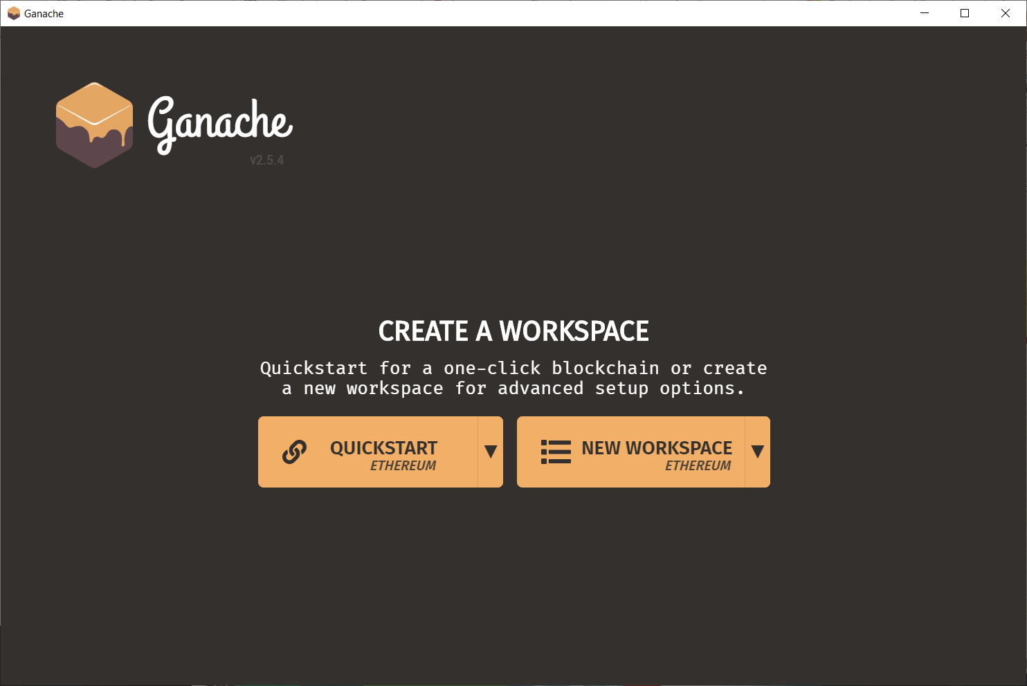
Just choose the default
Notes:
At first glance, it may seem that interleaving and overlapping represent fundamentally different modes of execution and present different problems. In fact, both techniques can be viewed as examples of concurrent processing, and both present the same problems. In the case of a uniprocessor, the problems stem from a basic characteristic of multiprogramming systems: The relative speed of execution of processes cannot be predicted. It depends on the activities of other processes, the way in which the OS handles interrupts, and the scheduling policies of the OS.

Slide 7
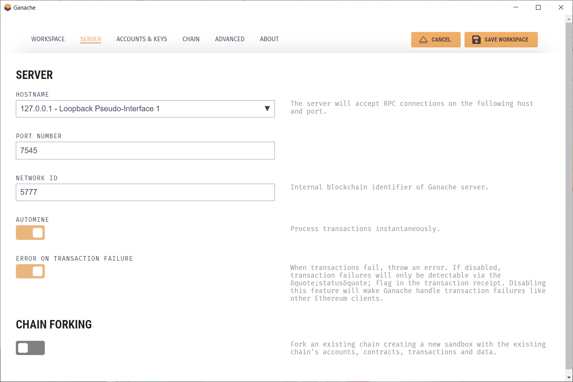
Note a few basic info
Notes:
At first glance, it may seem that interleaving and overlapping represent fundamentally different modes of execution and present different problems. In fact, both techniques can be viewed as examples of concurrent processing, and both present the same problems. In the case of a uniprocessor, the problems stem from a basic characteristic of multiprogramming systems: The relative speed of execution of processes cannot be predicted. It depends on the activities of other processes, the way in which the OS handles interrupts, and the scheduling policies of the OS.

Slide 8
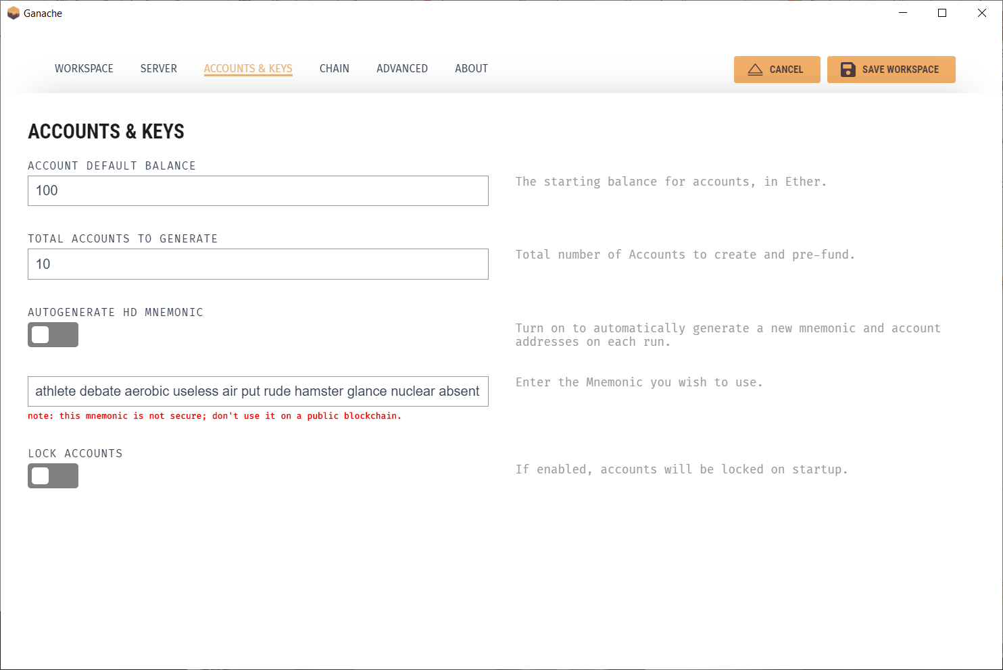
Note a few basic info
Notes:
At first glance, it may seem that interleaving and overlapping represent fundamentally different modes of execution and present different problems. In fact, both techniques can be viewed as examples of concurrent processing, and both present the same problems. In the case of a uniprocessor, the problems stem from a basic characteristic of multiprogramming systems: The relative speed of execution of processes cannot be predicted. It depends on the activities of other processes, the way in which the OS handles interrupts, and the scheduling policies of the OS.

Slide 9
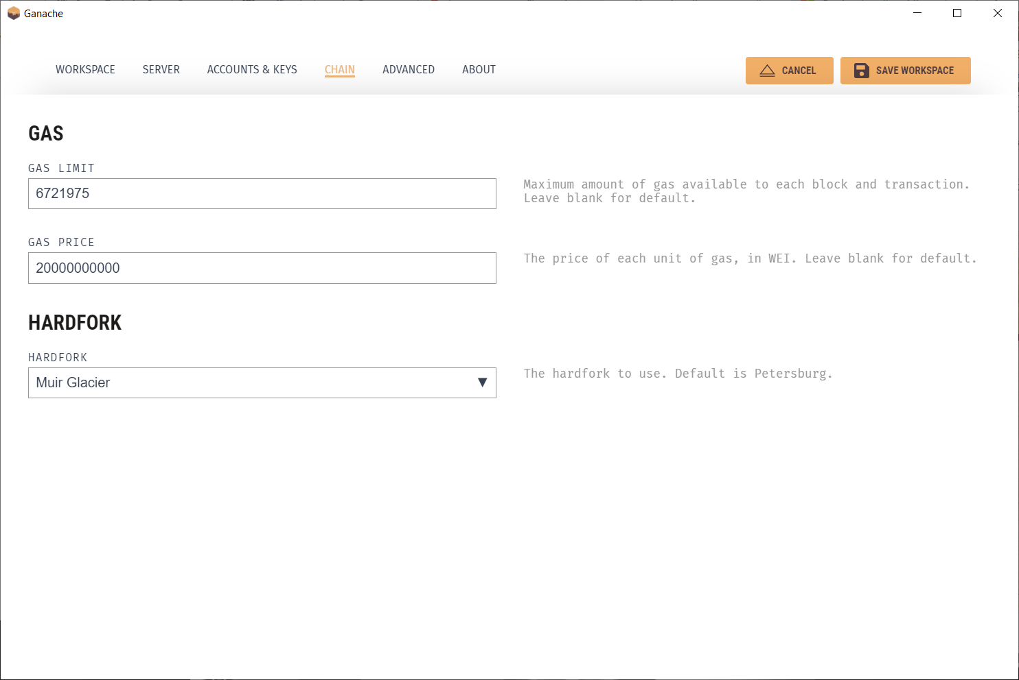
Note a few basic info
Notes:
At first glance, it may seem that interleaving and overlapping represent fundamentally different modes of execution and present different problems. In fact, both techniques can be viewed as examples of concurrent processing, and both present the same problems. In the case of a uniprocessor, the problems stem from a basic characteristic of multiprogramming systems: The relative speed of execution of processes cannot be predicted. It depends on the activities of other processes, the way in which the OS handles interrupts, and the scheduling policies of the OS.

Slide 10
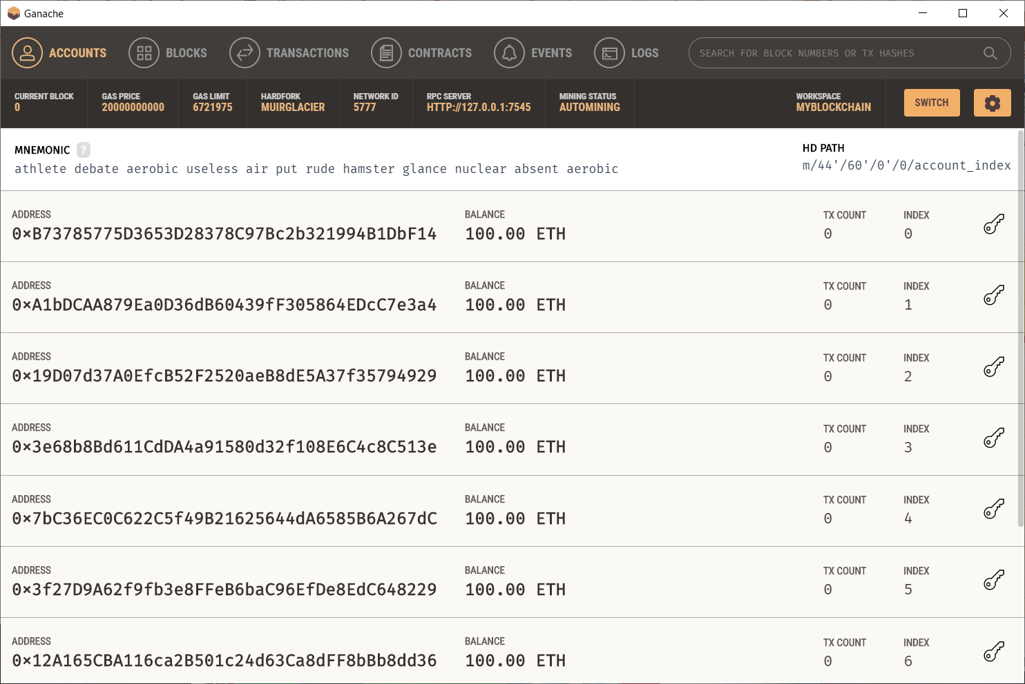
7 of the 10 accounts
Notes:
At first glance, it may seem that interleaving and overlapping represent fundamentally different modes of execution and present different problems. In fact, both techniques can be viewed as examples of concurrent processing, and both present the same problems. In the case of a uniprocessor, the problems stem from a basic characteristic of multiprogramming systems: The relative speed of execution of processes cannot be predicted. It depends on the activities of other processes, the way in which the OS handles interrupts, and the scheduling policies of the OS.

Slide 11
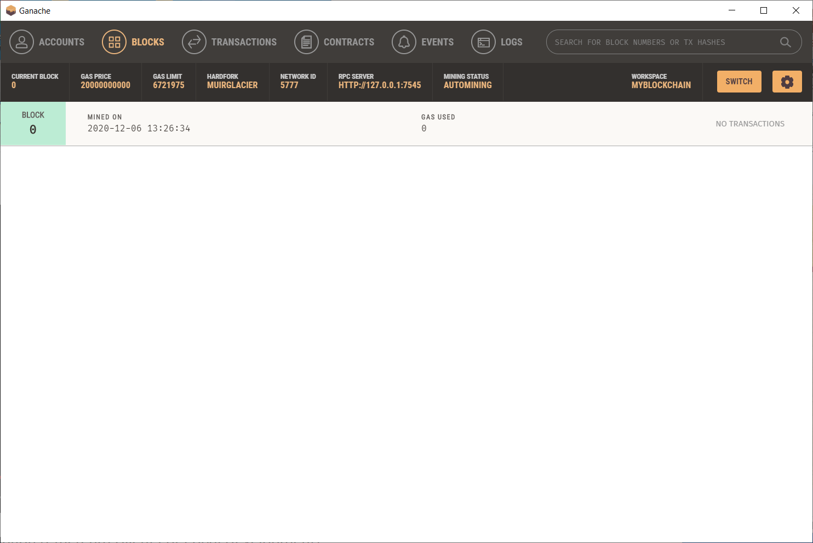
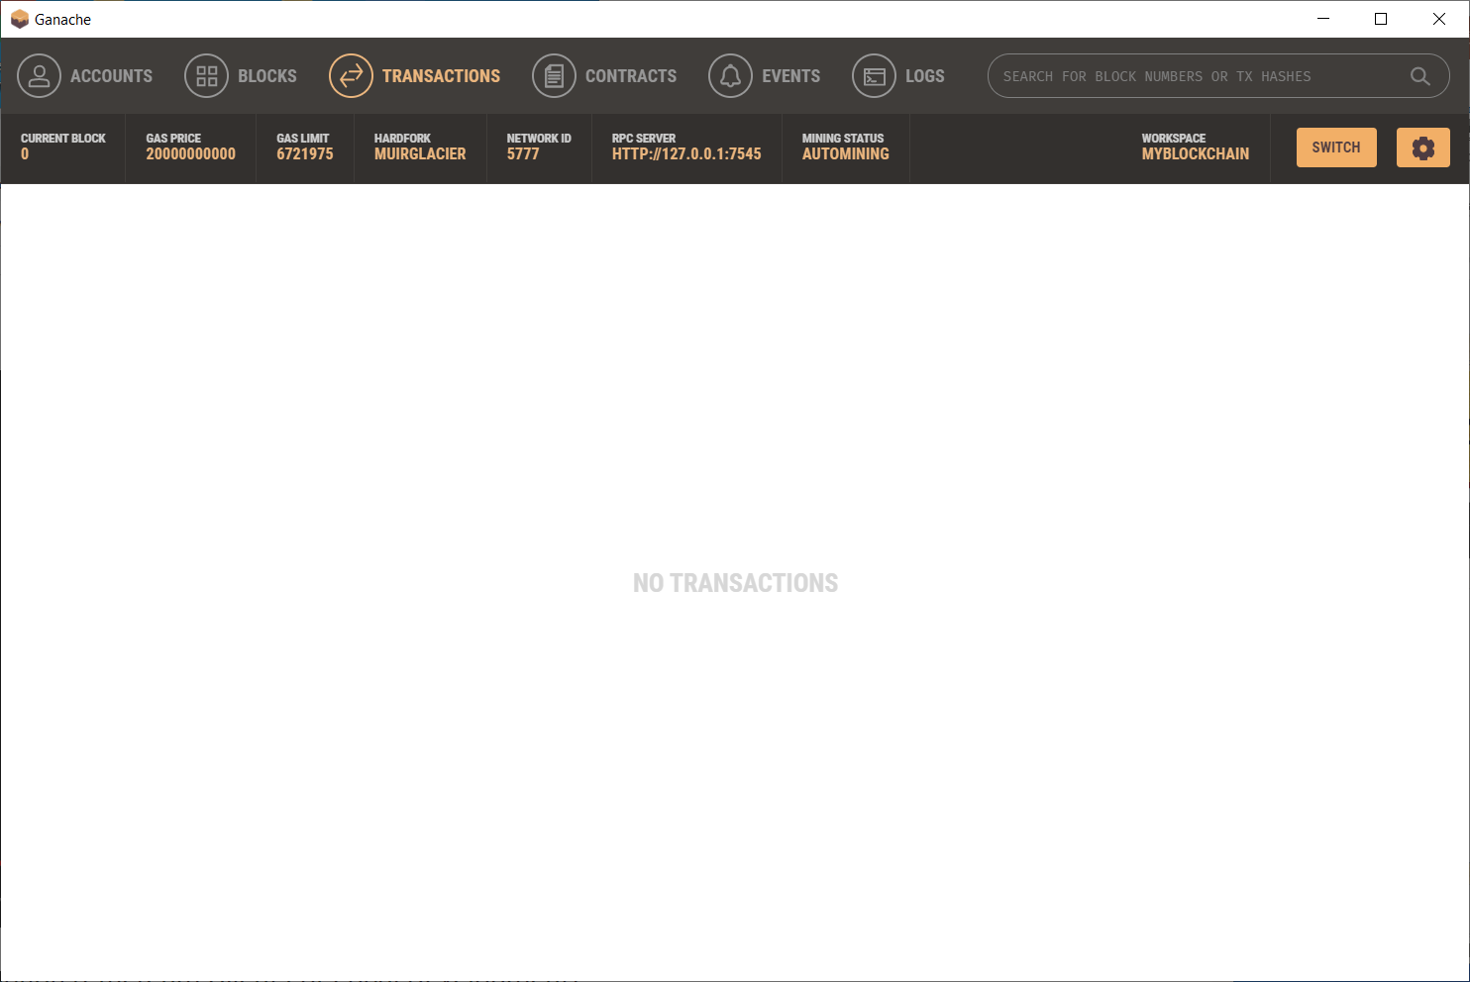
Starting – genesis block
Notes:
At first glance, it may seem that interleaving and overlapping represent fundamentally different modes of execution and present different problems. In fact, both techniques can be viewed as examples of concurrent processing, and both present the same problems. In the case of a uniprocessor, the problems stem from a basic characteristic of multiprogramming systems: The relative speed of execution of processes cannot be predicted. It depends on the activities of other processes, the way in which the OS handles interrupts, and the scheduling policies of the OS.

Slide 12
Installed via command line
This version is called ganache-cli (ie ganache-command line) This is the version preferred by serious developers, and it can do more things than the gui version.
Check page 363 of, Antenopolous
github URL for cloning
installation
Notes:
At first glance, it may seem that interleaving and overlapping represent fundamentally different modes of execution and present different problems. In fact, both techniques can be viewed as examples of concurrent processing, and both present the same problems. In the case of a uniprocessor, the problems stem from a basic characteristic of multiprogramming systems: The relative speed of execution of processes cannot be predicted. It depends on the activities of other processes, the way in which the OS handles interrupts, and the scheduling policies of the OS.

Slide 13

Youtube on installation
https://www.youtube.com/watch?v=ziRw31OTQOE
Notes:
At first glance, it may seem that interleaving and overlapping represent fundamentally different modes of execution and present different problems. In fact, both techniques can be viewed as examples of concurrent processing, and both present the same problems. In the case of a uniprocessor, the problems stem from a basic characteristic of multiprogramming systems: The relative speed of execution of processes cannot be predicted. It depends on the activities of other processes, the way in which the OS handles interrupts, and the scheduling policies of the OS.

Slide 14
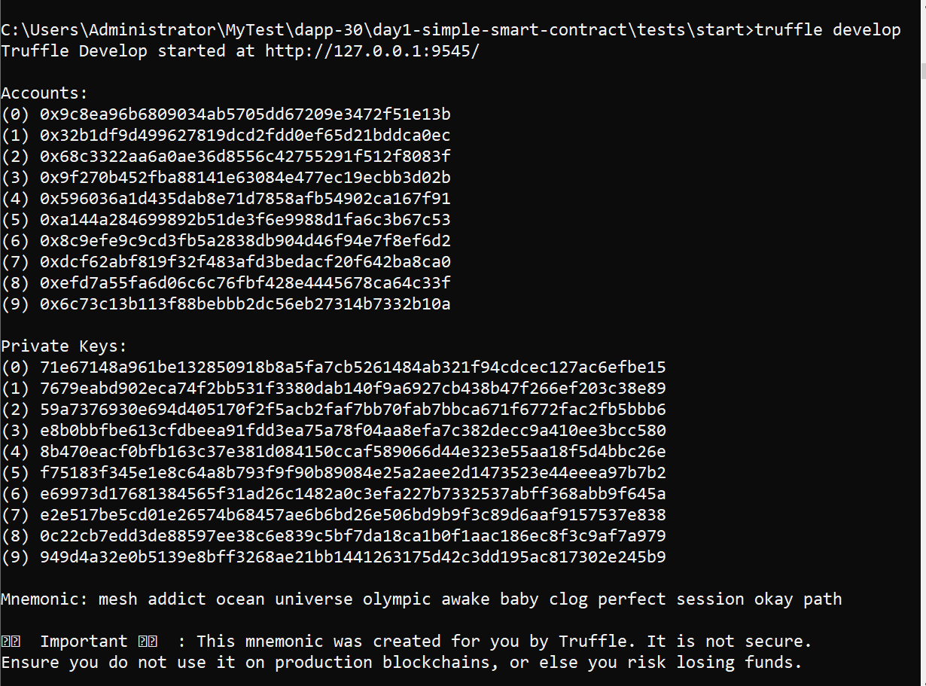
Launched via truffle command line
Notes:
At first glance, it may seem that interleaving and overlapping represent fundamentally different modes of execution and present different problems. In fact, both techniques can be viewed as examples of concurrent processing, and both present the same problems. In the case of a uniprocessor, the problems stem from a basic characteristic of multiprogramming systems: The relative speed of execution of processes cannot be predicted. It depends on the activities of other processes, the way in which the OS handles interrupts, and the scheduling policies of the OS.

Slide 15
End…
You must try it…
Notes:
At first glance, it may seem that interleaving and overlapping represent fundamentally different modes of execution and present different problems. In fact, both techniques can be viewed as examples of concurrent processing, and both present the same problems. In the case of a uniprocessor, the problems stem from a basic characteristic of multiprogramming systems: The relative speed of execution of processes cannot be predicted. It depends on the activities of other processes, the way in which the OS handles interrupts, and the scheduling policies of the OS.

